Slide 1
Computer Organization & Design 实验与课程设计
Computer Organization & Design
Lab 3
Integrated SOC Design
--CPU debug and test environment

Slide 2
Course Outline
Environment
Task
Principles
Implementation
Notes:
Rudimentary logic functions=基本的逻辑函数

Slide 3
Goal
1.Understand GPIO interface and device
2.Understand the organization of computer
3.Understand the relation of each part of computer
4.Understand the usage of IP core
5.Understand SOC system and implement it using IP cores

Slide 4
Environment
Setup
1. Computer（Intel Core i5，4GB memory）
2. Spartan-3 Starter Kit Board/Sword
3. Xilinx ISE14.4

Slide 5
Course Outline
Environment
Task
Principles
Implementation
Notes:
Rudimentary logic functions=基本的逻辑函数

Slide 6
Task
1. Analyze interface of IP core
2. Design IP module for memory
3. Master the usage of IP core
4. Use IP core and other designed modules to implement SOC
Top level: schematic

Slide 7
Course Outline
Environment
Task
Principles
Implementation
Notes:
Rudimentary logic functions=基本的逻辑函数

Slide 8
Computer Organization
computer systems
Software
Control unit
Path: multiplexors
ALU
Registers
……
CPU
Computer System
Datapath
Hardware
Memory
Input: PS2
SW、BTN
I/O interface
Bidirectional: Storage
Output: VGA
7-Seg、LED

Slide 9
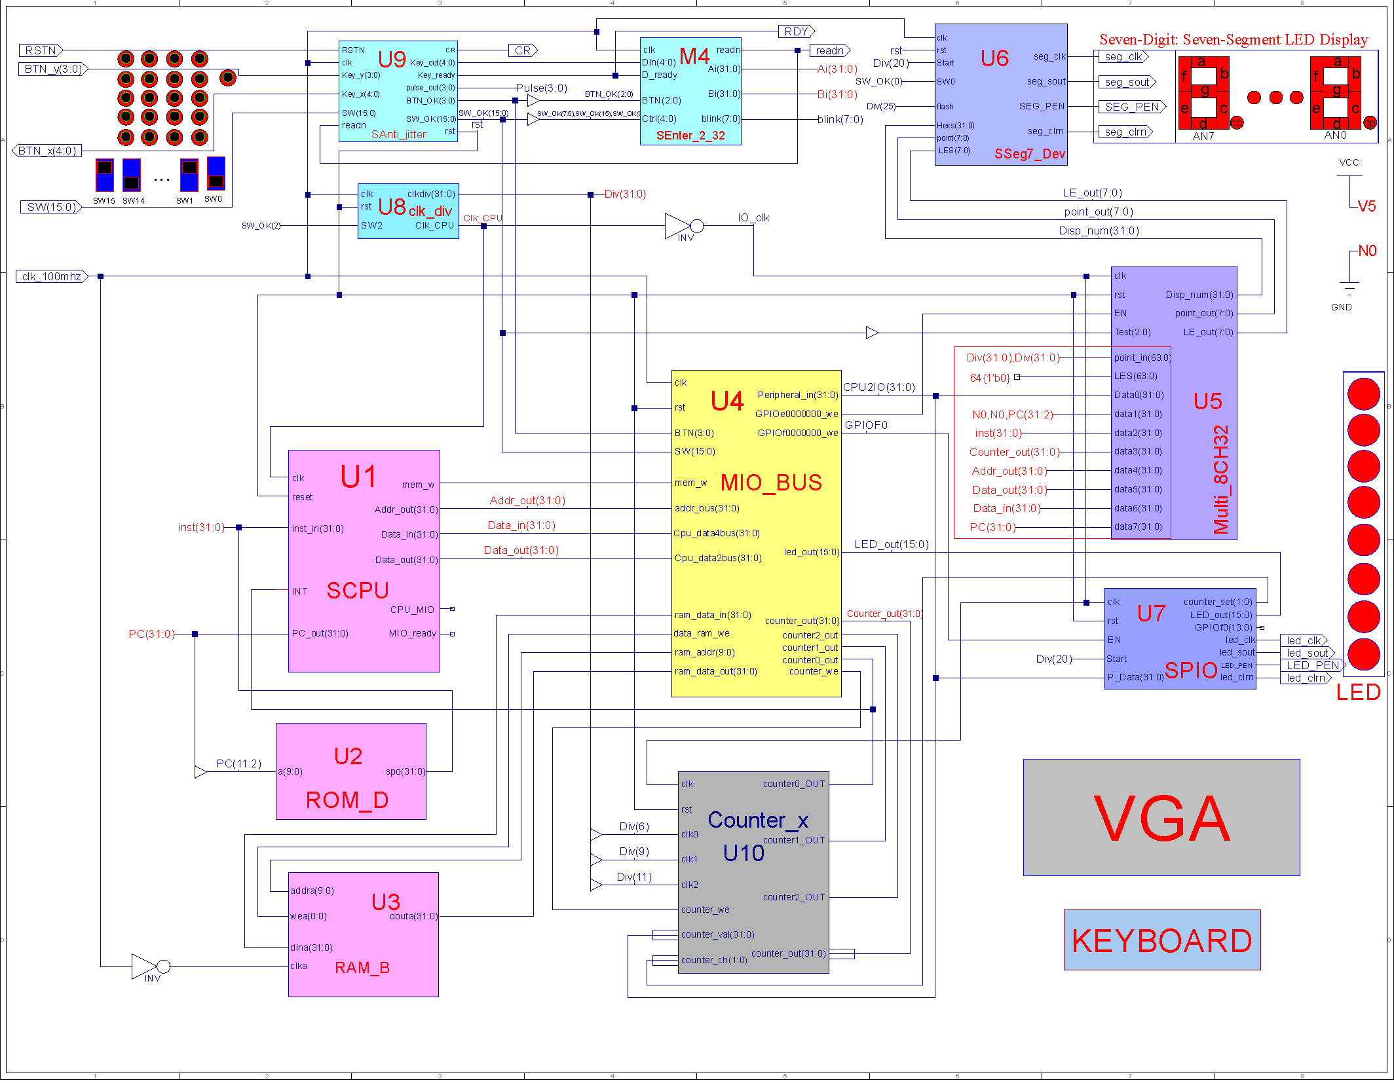
SOC system in this course
VGA
PS2

Slide 10
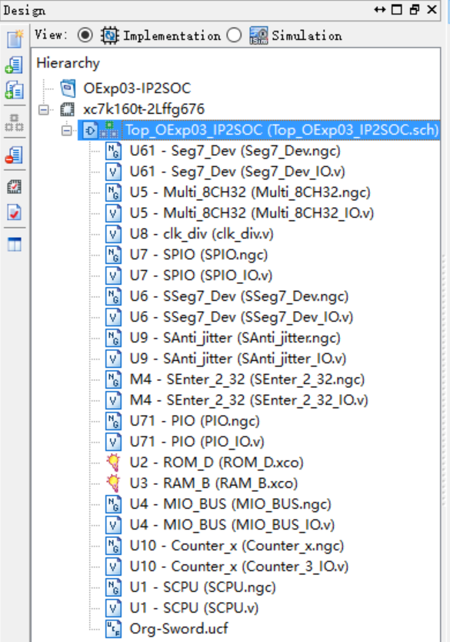
10 modules
10 modules used in SOC
U1： CPU -SCPU
U2： ROM -ROM_D
U3： RAM -RAM_B
U4： Bus(含外设3~4) -MIO_BUS
U5： 7-seg display interface -Multi_8CH32
U6： 7-seg display -Seg7_Dev
U7： GPIO and LED -PIO
U8： clock -clk_div
U9： Anti-jitter -Anti_jitter
U10：Counter -Counter_x

Slide 11
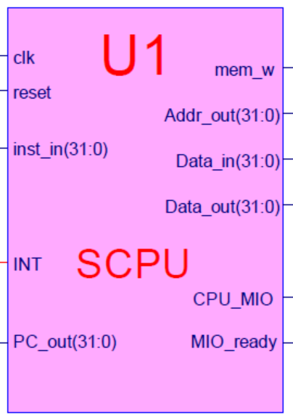
U1-CPU module：SCPU
MIPS architecture
RISC architecture
Three instruction types
Implemented instructions
Include following instructions
R-Type： add, sub, and, or, xor, nor, slt, srl*, jr, jalr, eret*；
I-Type：addi, andi, ori, xori, lui, lw, sw, beq, bne, slti
J-Type：J, Jal*；
IP Core- U1
Core module: SCPU.ngc
Interface file(empty file)：SCPU.v
Symbol file：SCPU.sym

Slide 12
SCPU.v
module SCPU( input wire clk,
input wire reset,
input wire MIO_ready, // Not used
input wire [31:0] inst_in, //instruction input
input wire [31:0]Data_in, //data input
output wire mem_w, //memory write control
output wire[31:0]PC_out, //PC pointer
output wire[31:0]Addr_out, //address
output wire[31:0]Data_out, //data output
output wire CPU_MIO, // Not used input wire INT //interupt
);
endmodule

Slide 13
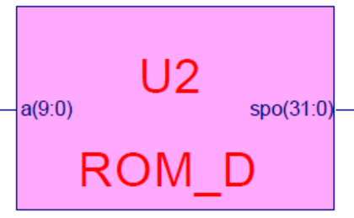
U2-ROM where instructions are stored：ROM_B
ROM_D/B
Use the modules designed in lab1
Internal memory in FPGA
Block Memory Generator or Distributed Memory Generator
capacity
1024×32bit
Symbol file：ROM_B.sym
The symbol may need to be modified
Use the core generated in lab1
ROM initialize：I9_mem.coe
Core calling module: ROM_B.xco
Linked automatically after it is generated
If there is no clk signal when using Distributed Memory Generator, please delete ”clka” pin

Slide 14
Call ROM_B
ROM interface
ROM_B U2 ( .clka(clk_m), //存储器时钟，与CPU反向
.addra(PC_out[11:2]), // ROM地址PC指针，来自CPU
.douta(inst[31:0]) // ROM输出作为指令输入CPU
);
Graphical input
ROM_B.sym
Core calling does not require empty file
Interface file

Slide 15
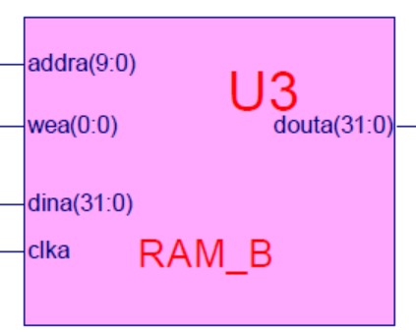
U3-data strorage：RAM_B
RAM_B
Internal memory of FPGA
Block Memory Generator
capacity
1024×32bit
Symbol file：RAM_B.sym
Required modification
Use core generated in lab1
RAM initialization：D_mem.coe
Core calling : RAM_B.xco
Linked automatically after it is generate

Slide 16
Calling RAM_B
RAM interface
RAM_B U3 ( .clka(clk_m), // 存储器时钟，与CPU反向
.wea(data_ram_we), // 存储器读写，来自MIO_BUS
.addra(ram_addr), // 地址线，来自MIO_BUS
.dina(ram_data_in), // 输入数据线，来自MIO_BUS
.douta(ram_data_out) // 输出数据线，来自MIO_BUS
);
Graphical input
RAM_B.sym
Core calling does not require empty file

Slide 17
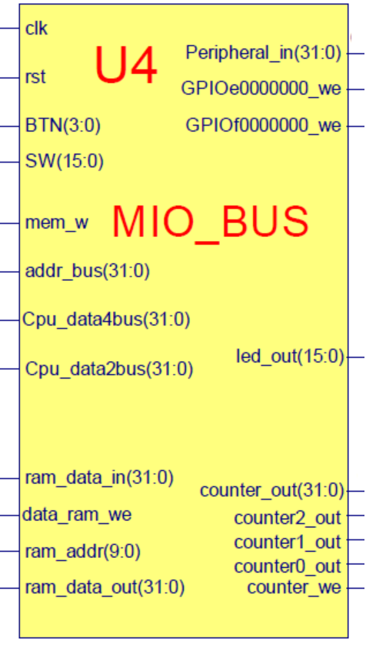
U4-BUS：MIO_BUS
MIO_BUS
The interface between CPU and data
Function
Data storage、the interface of 7-Seg、 SW、BTN and LED
In this lab, we use soft IP core U4
Core calling MIO_BUS.ngc
Interface file：MIO_BUS_IO.v
symbol：MIO_BUS.sym

Slide 18
IO BUS module-MIO_BUS.v
module MIO_BUS( input wire clk, input wire rst,
input wire [3:0] BTN, input wire [15:0]SW,
input wire mem_w,
input wire [31:0] Cpu_data2bus, //data from CPU
input wire [31:0] addr_bus, //addr from CPU
input wire [31:0] ram_data_out,
input wire [15:0] led_out,
input wire [31:0] counter_out,
input wire counter0_out,
input wire counter1_out,
input wire counter2_out,
output wire [31:0] Cpu_data4bus, //write to CPU
output wire [31:0] ram_data_in, //from CPU write to Memory
output wire [9: 0] ram_addr, //Memory Address signals
output wire data_ram_we,
output wire GPIOf0000000_w, // GPIOffffff00_we
output wire GPIOe0000000_we, // GPIOfffffe00_we
output wire counter_we, //记数器
output wire [31:0] Peripheral_in //送外部设备总线
);
endmodule

Slide 19
Signals of MIO_BUS module
MIO_BUS U4( clk_50M, //主板时钟
botton_out[3], //复位，按钮BTN3
BTN [3:0] , //4位原始按钮输入
SW [7:0], //8位原始开关输入
mem_w, //存储器读写操作，来自CPU
Cpu_data2bus [31:0] , //CPU输出数据总线
addr_bus [31:0] , //地址总线，来自CPU
ram_data_out [31:0] , //来自RAM数据输出
led_out [7:0], //来自LED设备输出
counter_out [31:0] , //当前通道计数输出，来自计数器外设
counter0_out, //通道0计数结束输出，来自计数器外设
counter1_out, //通道1计数结束输出，来自计数器外设
counter2_out, //通道2计数结束输出，来自计数器外设
Cpu_data4bus [31:0] , //CPU写入数据总线，连接到 CPU
ram_data_in [31:0] , //RAM 写入数据总线，连接到RAM
ram_addr [9: 0] , //RAM访问地址，连接到RAM
data_ram_we, //RAM读写控制， 连接到RAM
GPIOf0000000_w, // 设备一LED写信号
GPIOe0000000_we, // 设备二7段写信号，连接到U5
counter_we, //记数器写信号，连接到U10
Peripheral_in [31:0] //外部设备写数据总线，连接所有写设备
);
endmodule

Slide 20
GPIO interface module

Slide 21
U7-GPIO device interface 1-- SPIO
GPIO output device
address=f0000000 - ffffffff0 (ffffff00-ffffffff0)
Read/write control signal：GPIOf0000000_we(GPIOffffff00_we)
{GPIOf0[21:0],LED,counter_set}
Function
LEDs and counter 控制器读写
可回读，检测状态
In this lab, we use soft IP core- U7
Core calling: SPIO.ngc
interface file：SPIO_IO.v
symbol：SPIO.sym
rst
Device GPIO
& LED
22位
GPIOf0
Peripheral_in
Counter_set
8-LED
GPIOf0000000_we
led_out
clk_io

Slide 22
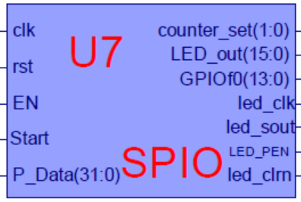
Interface file -SPIO.v
module SPIO(input clk, //io_clk，与CPU反向
input rst,
input EN, //来自U4
input [31:0] P_Data, //来自U4
input Start //串行输出启动
output [1:0] counter_set, //来自U7，后继用
output [15:0] led_out, //输出到LED,回读到U4
output [23:0] GPIOf0 //备用
output led_clk, //串行时钟
output led_sout, //串行LEDE值
output LED_PED, //LED使能
output led_clrn //LED清零
);
endmodule

Slide 23
U6-GPIO device 2： Seg7_Dev
7-seg display module
Connect to CPU through Multi_8CH32
address=E0000000 - EFFFFFFF (FFFFFE00-FFFFFEFF)
Function (refer to lab2)
Use soft IP core - U5
SSeg7_Dev.ngc
SSeg7_Dev.v
SSeg7_Dev.sym

Slide 24
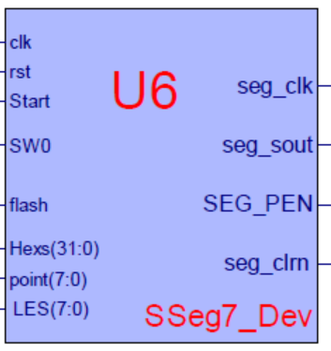
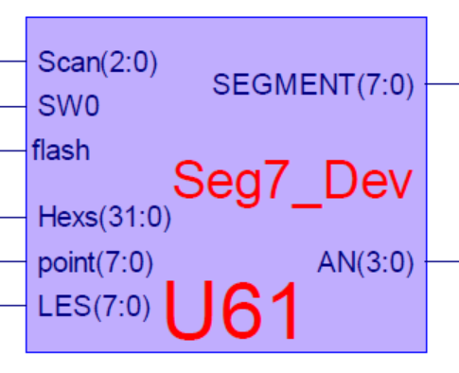
Interface file ~Seg7_Dev.v
module SSeg7_Dev(input clk, //时钟
input rst, //复位
input Start, //串行扫描启动
input SW0, //文本(16进制)/图型(点阵)切换
input flash, //七段码闪烁频率
input[31:0]Hexs, //32位待显示输入数据
input[7:0]point, //七段码小数点：8个
input[7:0]LES, //七段码使能：=1时闪烁
output seg_clk, //串行移位时钟
output seg_sout, //七段显示数据(串行输出)
output SEG_PEN, //七段码显示刷新使能
output seg_clrn //七段码显示清零
);
endmodule
module Seg7_Dev(input wire [31:0] disp_num, //来自U5
input wire [1:0]SW, //来自U9
input wire flash_clk, //通用分频器
input wire [1:0] Scanning, //来自U8
input wire [3:0] pointing, //来自U5
input wire [3:0] blinking, //来自U5
output wire [3:0] AN,
output reg [7:0] SEGMENT ); //来自U5
endmodule

Slide 25
U5- Interface module Multi_8CH32
GPIO output interface module
address=E0000000 - EFFFFFFF (FFFFFE00-FFFFFEFF)
Read/write control signal：GPIOe0000000_we(GPIOfffffe00_we)
Function (refer to Exp02)
Data0 as the display interface
GPIOe0000000_we=1
CLK positive edge
Data1-data7: debug signal
Use soft IP core U6
核调用模块Multi_8CH32.ngc
核接口信号模块(空文档)： Multi_8CH32_IO.v
核模块符号文档：Multi_8CH32.sym
rst
Test_data0
GPIO
Multi_8CH32
Seg7 Device
…
…
Test_data7
Peripheral_in
GPIOe0000000_we
disp_num
Peripheral_in
clk_io

Slide 26
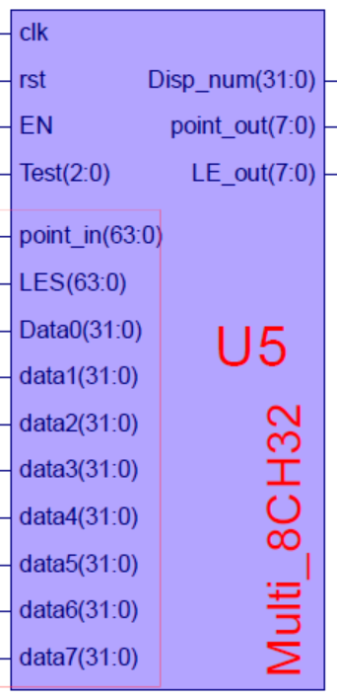
Interface file -Multi_8CH32_IO.v
module Multi_8CH32 ( input clk, //io_clk，同步CPU
input rst,
input EN, //=1, 通道0显示
input[63:0]point_in, //针对8个显示通道各8个小数点
input[63:0]blink_in, //针对8个通道各8位闪烁控制
input [2:0] Test, //通道选择SW[7:5]
input [31:0] Data0, //通道0
input [31:0] data0, //通道1
input [31:0] data1, //通道2
input [31:0] data2, //通道3
input [31:0] data3, //通道4
input [31:0] data4, //通道5
input [31:0] data5, //通道6
input [31:0] data6, //通道7
output reg[3:0] point_out, //小数点输出
output reg[3:0] blink_out, //闪烁控制输出
output [31:0] disp_num //接入7段显示器
);
endmodule

Slide 27
Signals of Multi_8CH32
Multi_8CH32 U5( .clk(clk_io), .rst(rst),
. EN(GPIOe0000000_we), //来自U4
. point_in(point_in), //外部输入
.blink_in(blink_in), //外部输入
.Test(SW_OK[7:5]), //来自U9
.Data0(Peripheral_in), //来自U4
.data1({2‘b00,PC_out[31:2]}), //来自U1
.data2(counter_out), //来自U10
.data3(Inst), //Inst，来自CPU
.data4(addr_bus), //来自CPU
.data5(Cpu_data2bus), //来自CPU
.data6(Cpu_data4bus), //来自CPU
.data7(PC_out), //来自CPU;
.point_out(point_out), //输出到U6
.blink_out(blink_out), //输出到U6
.disp_num(disp_num) //输出到U6
);

Slide 28
GPIO device interface 3,4: Device_GPIO_SW_BTN
8-bits Switch and 4-bits Button input
address= f0000000-ffffffff0，A[2]=0
These two devices are included in U4，MIO_BUS
Relation with CPU data bus（when addre_bus=f0000000）
Cpu_data4bus = {counter0_out, counter1_out, counter2_out, 1'h000, BTN,SW};
mem_w=0
addre_bus=f0000000
CPU
Led out
BTN
Cpu_data4bus
SW
clk_io

Slide 29
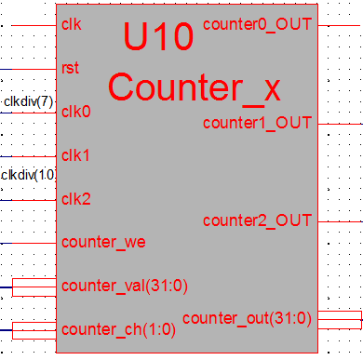
U10-peripheral device 5: Counter_x.v
General counter，
address=F0000004 – FFFFFFF4 (FFFFFF04-FFFFFFF4)
r/w control：counter_we
Function
3 paths independent counter
Output for choose path or initialization
counter_set=00、01、10 for path0、1、2
counter_set=11对应计数通道工作设置
Use soft IP core- U10
核调用模块Counter_x.ngc
核接口信号模块(空文档)：Counter_x.v
核模块符号文档：Counter_x.sym

Slide 30
Interface file -Counter_x.v
module Counter_x(input clk, //io_clk
input rst,
input clk0, //clk_div[7]，来自U8
input clk1, // clk_div[10]，来自U8
input clk2, //clk_div[10]，来自U8
input counter_we, //计数器写控制，来自U4
input [31:0] counter_val, //计数器输入数据，来自U4
input [1:0] counter_ch, //计数器通道控制，来自U7
output counter0_OUT, //输出到U4
output counter1_OUT, //输出到U4
output counter2_OUT, //输出到U4
output [31:0] counter_out //输出到U4
);
endmodule

Slide 31
SOC auxiliary modules
U8：clk_div
U9：anti-jitter
Refer to previous lab

Slide 32
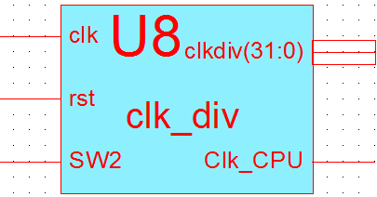
clk_div.v
module clk_div(input clk,
input rst,
input SW2,
output [31:0]clkdiv,
output Clk_CPU
);
endmodule

Slide 33
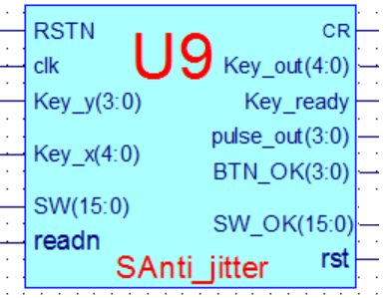
Anti_jitter.v
module SAnti_jitter(input clk, //主板时钟
input RSTN
input readn //阵列式键盘读
input [3:0]Key_y, //阵列式键盘列输入
output reg[4:0] Key_x, //阵列式键盘行输出
output reg[4:0] Key_out,//阵列式键盘扫描码
output reg Key_ready, //阵列式键盘有效
input [15:0] SW, //开关输入
output reg [3:0] ] BTN_OK,//列按键输出
output reg [3:0] pulse, //列按键脉冲输出
output reg [15:0] SW_OK, //开关输出
output reg CR, //RSTN短按输出
output reg rst //复位， RSTN长按输出
);
endmodule

Slide 34
Course Outline
Environment
Task
Principles
Implementation
Notes:
Rudimentary logic functions=基本的逻辑函数

Slide 35
Project ：OExp03-IP2SOC
Build platform for CPU debug and application
Use schematic implementation on top，call IP core
File name：Top_OExp03_IP2SOC.sch
SOC platform
Use the modules in lab1 and lab2 and given IP cores.
CPU (given IP core)：U1
ROM (ISE IP 核)：U2
RAM (ISE IP核)：U3
Bus (given IP核)：U4
Multiplexer(lab1 Multi_8CH32)：U5
7-seg display(lab2 SSeg7_Dev IP)：U6
LED display (lab2 SPIO)：U7
Clock (clk_div)：U8
Anti-jitter (IP核)：U9
Data input (IP核)：M4(no use for the moment)

Slide 36
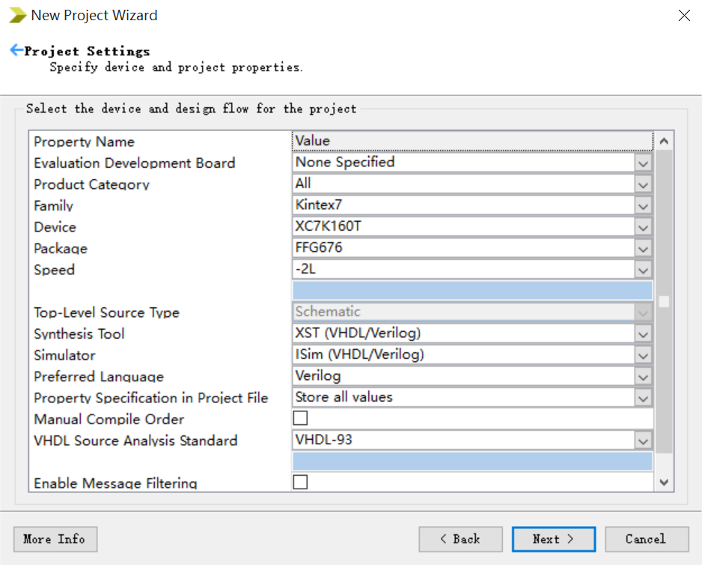
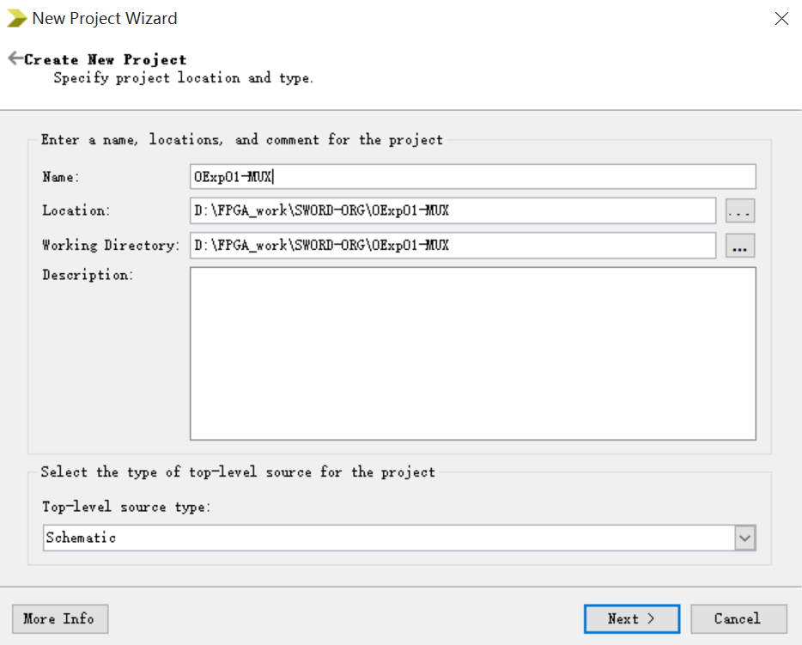
Create SOC project
Start ISE software
File→ New Project，type project name：OExp03-IP2SOC or Top_Simple_CPU_App
Next, next, finish
This project is shared by following experiment: a simple implementation of CPU

Slide 37
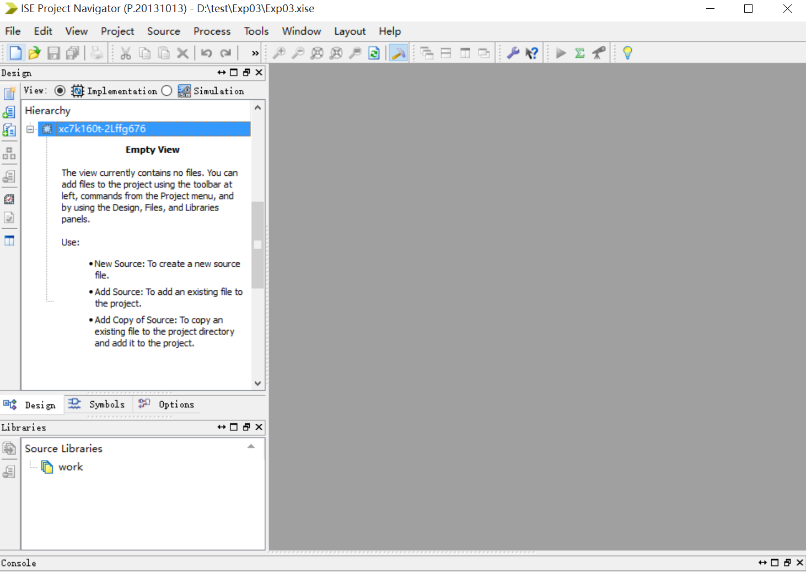
SOC project

Slide 38
Copy symbol files of U1~U10 to current project
Copy .ngc files of U1~U10 to current project

Slide 39
SOC top level: schematic
--add U1、U2、U3、U4 and U10 based on lab2

Slide 40
SOC schematic

Slide 41
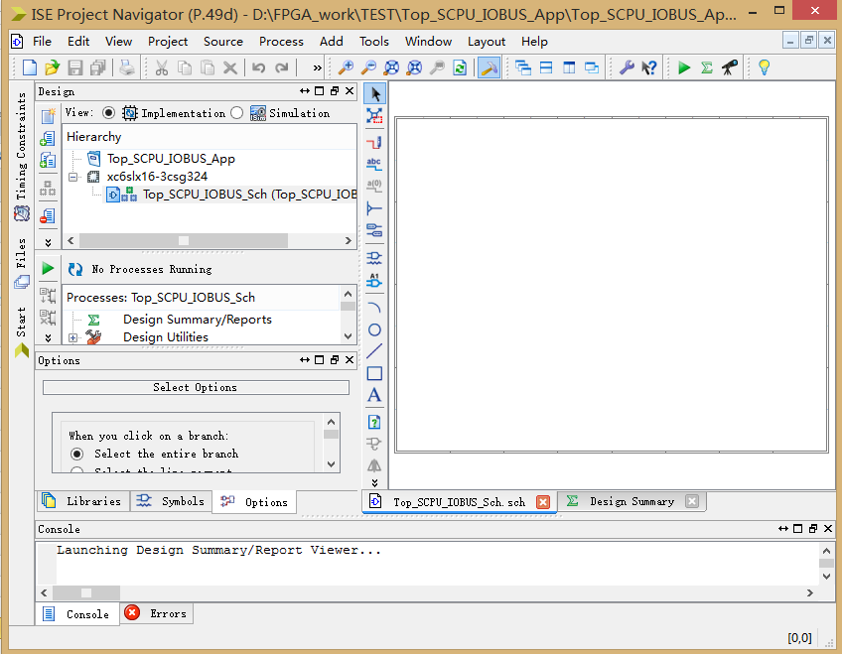

Slide 42
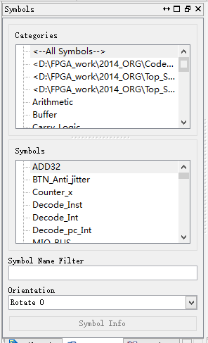
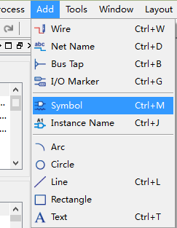
Add modules

Slide 43
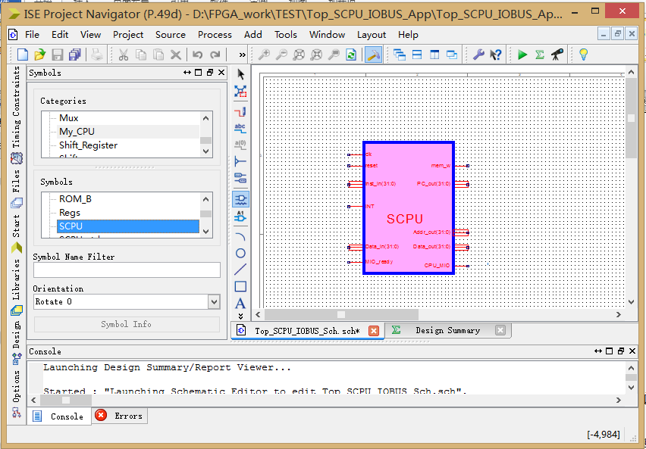
Add CPU module

Slide 44
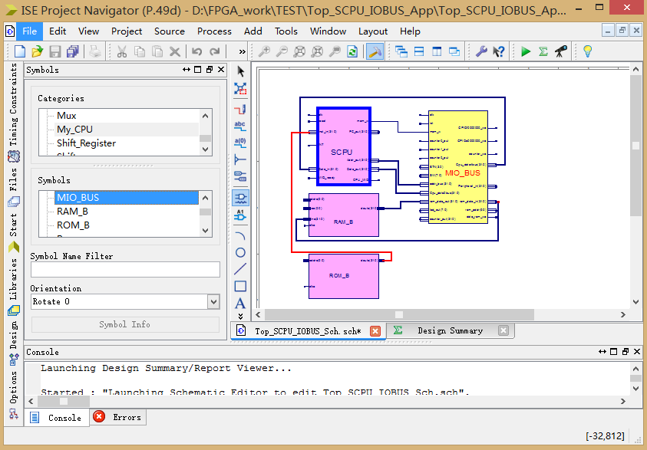
Add more modules and connect

Slide 45
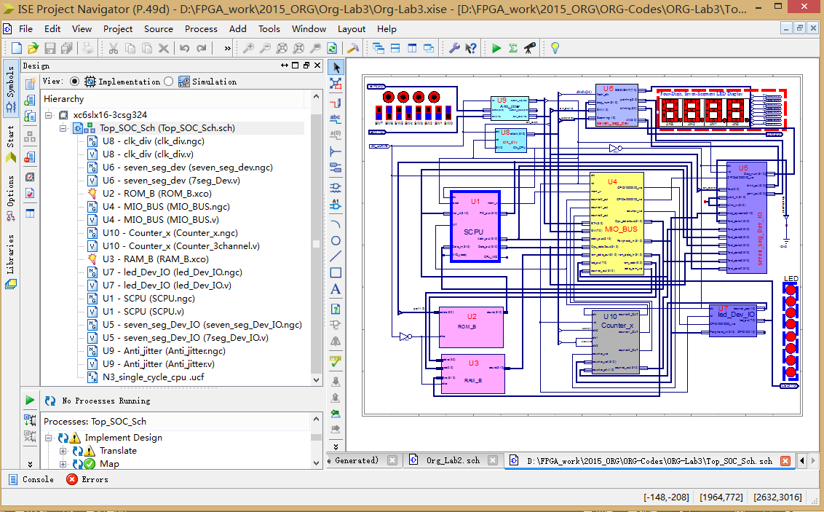
Finish
CPU核

Slide 46
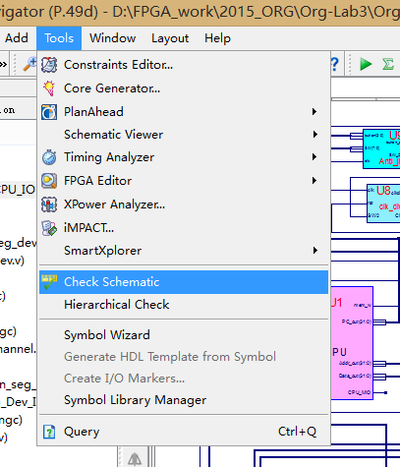
Check schematic

Slide 47
Link to modules
连接模块的接口信号
模块放置后根据顶层分解图连接各模块
信号连线时注意各信号之间的合理布线距离
当连线较近时注意不要同时选中多个信号节点：NET
顶层调用模块关联
顶层窗口放置模块Symbol后会直接调用对应模块
建立核端口模块与软核模块关联
只有端口信号的模块，没有逻辑代码的空文档.v
综合器会根据端口模块连接信号
Click “Add Source”, choose the corresponding .v file

Slide 48
Memory IP core reinitialize

Slide 49
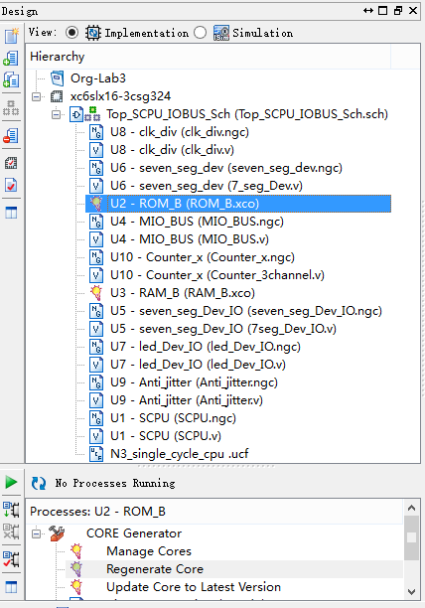
ROM_B reinitialize
Use I9_men.coe to initialize ROM
In Design window, double click U2
Double click ROM_B
Or select ROM_B
In Processes Running windown double click Manager Core
In manage cores window, click Next
Core is generated

Slide 50
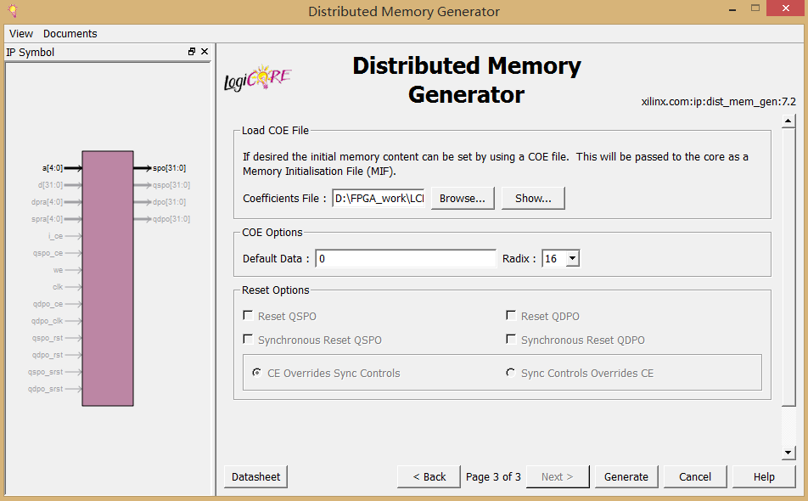
〖第四步〗link to initialize file to generate ROMIP core
Click Next，skip page 2, page 3 pop up
Click“Browse...” choose I9_men.coe
Click Generate to generate ROM core
点击Browse关联 Init File
点击查验
I9_men.coe
最后点击生成
查看Datasheet

Slide 51
ROM initialization file：.coe
ROM.coe format
Can be open and edit in ISE or other text editor
format：
Line 1：initialization_radix is HEX（also can be binary）
Line 2：initialization vector
Start line 3：elements of initialization, separated by “,” and ended with ”;”
Add Comment with“#”at beginning or ending of the file，not allowed in the midddle
memory_initialization_radix=16;
memory_initialization_vector=
00000827, 0001102a, 00421820, 00622020, 00832820, 00a43020,
00c53820, 00e64020, 01074820, 01285020, 01495820, 016a6020,
018b6820, 01ac7020, 01cd7820, 01ee8020, 020f8820, 02309020,
02519820, 0272a020, 0293a820, 02b4b020, 02d5b820, 02f6c020,
0317c820, 0338d020, 0359d820, 037ae020, 039be820, 03bcf020,
03ddf820, 08000000;
The above data is some test instructions
Used in CPU simulation
Use I9_mem.coe when downloading to board

Slide 52
Simple test instructions
#baseAddr 0000
loop: nor r1,r0,r0; //r1=FFFFFFFF
slt r2,r0,r1; //r2=00000001
add r3,r2,r2; //r3=00000002
add r4,r3,r2; //r4=00000003
add r5,r4,r3; //r5=00000005
add r6,r5,r4; //r6=00000008
add r7,r6,r5; //r7=0000000d
add r8,r7,r6; //r8=00000015
add r9,r8,r7; //r9=00000022
add r10,r9,r8; //r10=00000037
add r11,r10,r9; //r11=00000059
add r12,r11,r10; //r12=00000090
add r13,r12,r11; //r13=000000E9
add r14,r13,r12; //r14=00000179
add r15,r14,r13; //r15=00000262
add r16,r15,r14; //r16=000003DB
add r17,r16,r15; //r17=000006D3
add r18,r17,r16; //r18=00000A18
add r19,r18,r17; //r19=000010EB
add r20,r19,r18; //r20=00001B03
add r21,r20,r19; //r21=00003bEE
add r22,r21,r20; //r22=000046F1
add r23,r22,r21; //r23=000080DF
add r24,r23,r22; //r24=0000C9D0
add r25,r24,r23; //r25=00014AAF
add r26,r25,r24; //r26=0001947F
add r27,r26,r25; //r27=0012DF2E
add r28,r27,r26; //r28=001473AD
add r29,r28,r27; //r29=002752DB
add r30,r29,r28; //r30=003BC688
add r31,r30,r29; //r31=00621963
j loop;

Slide 53
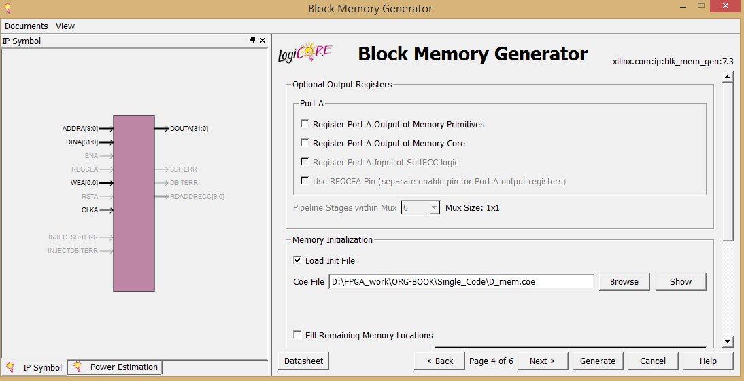
RAM_B initialize
Same as ROM, click Next, enter page 4
〖step 4〗link to initialization file (D_men.coe) to generate RAM IP core
点击选中Load Init File
点击Browse关联 Init File
点击查验
最后点击生成
查看Datasheet

Slide 54
RAM initialization file --.coe
D_mem.coe
memory_initialization_radix=16;
memory_initialization_vector=
f0000000, 000002AB, 80000000, 0000003F, 00000001, FFF70000, 0000FFFF, 80000000, 00000000, 11111111, 22222222, 33333333, 44444444, 55555555, 66666666, 77777777, 88888888, 99999999, aaaaaaaa, bbbbbbbb, cccccccc, dddddddd, eeeeeeee, FFFFFFFF, 557EF7E0, D7BDFBD9, D7DBFDB9, DFCFFCFB, DFCFBFFF, F7F3DFFF, FFFFDF3D, FFFF9DB9, FFFFBCFB, DFCFFCFB, DFCFBFFF, D7DB9FFF, D7DBFDB9, D7BDFBD9, FFFF07E0, 007E0FFF, 03bdf020, 03def820, 08002300;
Can be used for simulation and verification on board
Red data is for LED graphics

Slide 55
SOC physical verification
-just use demo to test functions

Slide 56
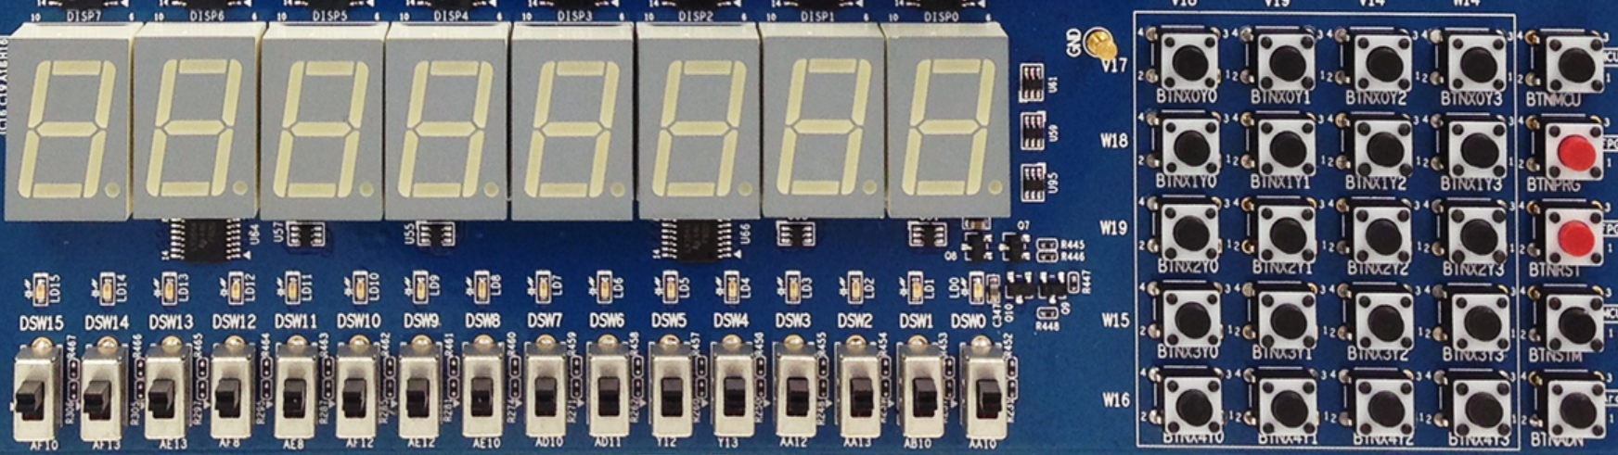
DEMO interface
X₀Y₀
X₀Y₁
X₀Y₂
X₀Y₃
MCU3
0
1
2
3
X₁Y₀
X₁Y₁
X₁Y₂
X₁Y₃
PRGO
SEG3
SEG2
SEG1
SEG0
SEG3
SEG2
SEG1
SEG0
4
5
6
7
X₂Y₀
X₂Y₁
X₂Y₂
X₂Y₃
RSTN
LED15 LED14 LED13 LED12 LED11 LED10 LED9 LED8 LED7 LED6 LED5 LED4 LED3 LED2 LED1 LED0
8
9
A
B
X₃Y₀
X₃Y₁
X₃Y₂
X₃Y₃
MCU1~2
C
D
E
F
W15 SW14 SW13 SW12 SW11 SW10 SW9 SW8 SW7 SW6 SW5 SW4 SW3 SW2 SW1 SW0
X₄Y₀
X₄Y₁
X₄Y₂
X₄Y₃
Ardunio
SW[7:5]=choose datapath
SW[7:5]=000：output when CPU runs the program
SW[7:5]=001：PC word address
SW[7:5]=010：instruction word
SW[7:5]=011：counter
SW[7:5]=100：RAM address
SW[7:5]=101：CPU data output
SW[7:5]=110：CPU data input
SW[0]=text/graphics
SW[1]=upper/lower 16-bits
No use
SW[2]=CPU_clk
SW[4:3]=00，display bit-map：marquee
SW[4:3]=00，display bit-map：matrix transform
SW[4:3]=01，display memory data：0～F
SW[4:3]=10，display current reg+1

Slide 57
SOC verification
Simulation
Do Simulations for your own designed modules
SOC verification
Download .bit file
verify SOC functions
observe SOC key signals
Substitute I9_mem.coe by test data

Slide 58
Switch settings
Graphics test
文本功能测试
开关 | 位置 | 功能
SW[1:0] | X0 | 7-seg graphical display
SW[2] | 0 | CPU high frequency clock
SW[4:3] SW[4:3] | 00 11 | Light of 7-seg shift right from top down Each bit of Big Rectangle of 7-seg lights in order
SW[7:5] | 000 | For peripherals（E0000000/FFFFFE00）
开关 | 位置 | 功能
SW[1:0] | 01 11 | Display text on 7-seg (lower 16-bits) Display text on 7-seg (upper 16-bits)
SW[2] | 0 | CPU high frequency clock
SW[4:3] SW[4:3] | 01 10 | Display RAM number on 7-seg Display add on 7-seg
SW[7:5] | 000 | For peripherals（E0000000/FFFFFE00）

Slide 59
Qualitative observation
SOC signal test
CPU high speed running
Test switch setting
开关 | 位置 | 功能
SW[1:0] | 01 | Display text on 7-seg (lower 16-bits)
SW[1:0] | 11 | Display text on 7-seg (upper 16-bits)
SW[2] | 0 | CPU high speed clk
SW[7:5] | 010 | Counter output
SW[7:5] | 100 | CPU数据存储地址addr_bus（ALU）
SW[7:5] | 101 | CPU数据输出Cpu_data2bus (寄存器B)
SW[7:5] | 110 | CPU数据输入Cpu_data4bus(RAM输出)

Slide 60
Qualitative observation
SOC信号测试
CPU low speed running
Test switch settings
Use test data to substitute DEMO *
开关 | 位置 | 功能
SW[1:0] | 01 | 七段码文本显示（低16位）
SW[1:0] | 11 | 七段码文本显示（高16位）
SW[2] | 1 | CPU单步时钟
SW[7:5] | 001 | CPU指令字地址PC_out[31:2]
SW[7:5] | 011 | ROM指令输出Inst_in
SW[7:5] | 100 | CPU数据存储地址addr_bus(ALU输出)
SW[7:5] | 101 | CPU数据输出Cpu_data2bus(寄存器B)
SW[7:5] | 110 | CPU数据输入Cpu_data4bus(RAM输出)
SW[7:5] | 111 | CPU指令字节地址PC_out

Slide 61
END

